Slide 1
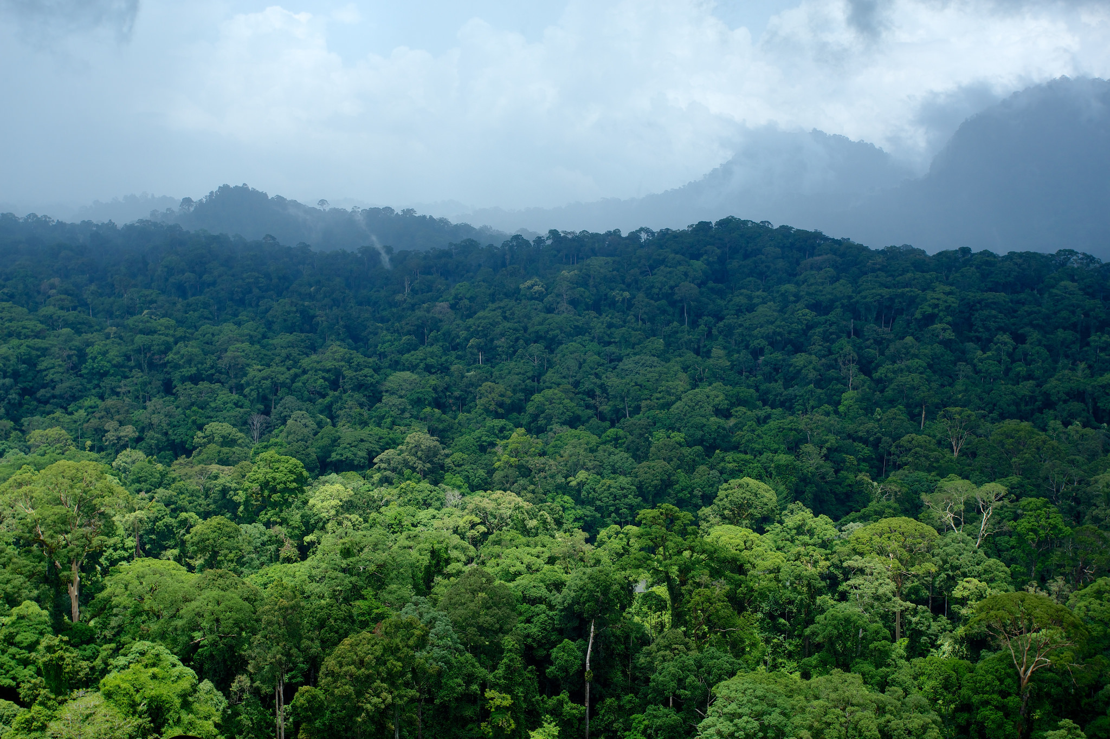

Deforestation Prediction: Where are the world’s forests at risk?
Rachael Petersen
Intro to Data Science (DAT5)
Monday, April 27th, 2015
Notes:
Talk today about the role that big data can play in supporting our common goal to halt deforestation in primary forests.
I lead an initiative at WRI called Global Forest Watch, which is a new, online forest monitoring and alerting system that we launched in February of this year with over 40 partners. At GFW, we believe that data, and particularly open data, is a critical and unfortunately often lacking input for effective decision-making.
In particular, and in the context of International Development, I think that data can do three really important things for us:
Make the case – when we need to convince policy-makers and other decision-makers that global action is needed
Made decisions – so our priorities, strategies, and interventions are guided by evidence
Make progress – need to see if we are actually meeting the commitments we have made. If we are failing, need to see that to. And we need to understand when, where, and why we are succeeding or failing.
But in order for data to be useful in these way, it needs to be:
Globally consistent
Frequently updated
Spatially explicit and precise

Slide 2
The Question
Can we predict the locations where large-scale forest clearing is most likely to occur next?

Slide 3

Notes:
Having satellite imagery is allowing us to keep companies accountable for their actions, remotely monitor how development is affecting ecosystems.
Facing legal action against this company for clearing closed-canopy primary forest.
This is all great, but ideally we would catch this behavior before it happens, or at least identify hotspots or areas where it is most likely to occur.

Slide 4
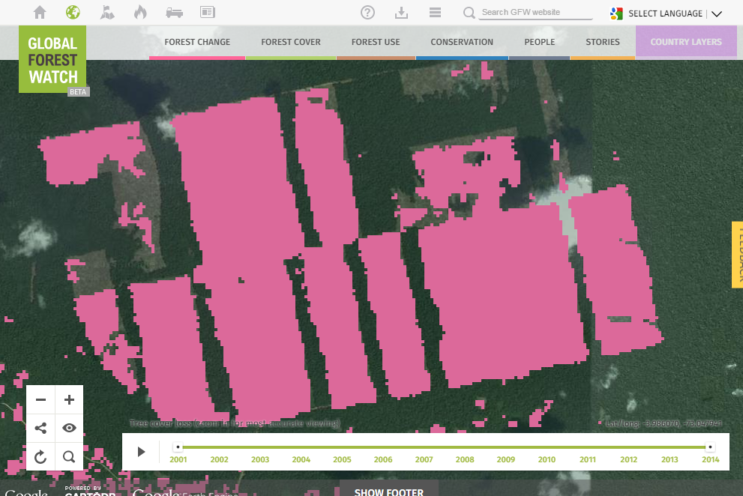
Notes:
What did we create? What is global forest watch?
Online global forest monitoring and management platform
Harnesses power
satellite imagery
cloud computing
crowdsourcing
open data
Provide free, accessible, easy-to-understand information about what’s happening in forests around the world in near-real time
GATHER forest information from
satellite imagery
open data from governments, companies, NGOs, etc,
on the ground
ANALYZE using cloud computing, GIS, etc.
SHARE with everyone, but most importantly with key decision makers

Slide 5
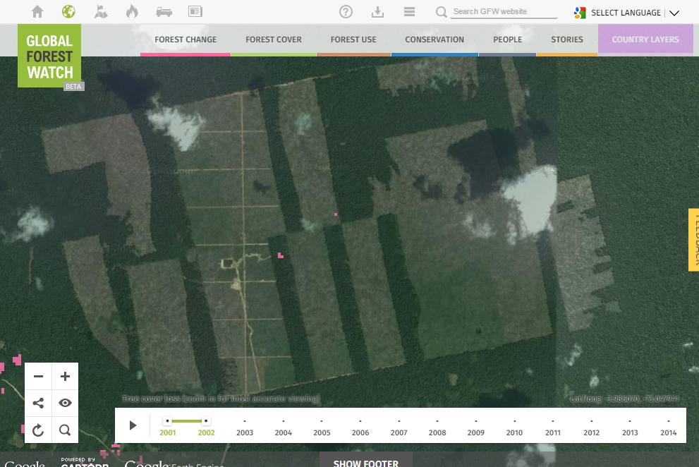
Notes:
What did we create? What is global forest watch?
Online global forest monitoring and management platform
Harnesses power
satellite imagery
cloud computing
crowdsourcing
open data
Provide free, accessible, easy-to-understand information about what’s happening in forests around the world in near-real time
GATHER forest information from
satellite imagery
open data from governments, companies, NGOs, etc,
on the ground
ANALYZE using cloud computing, GIS, etc.
SHARE with everyone, but most importantly with key decision makers

Slide 6
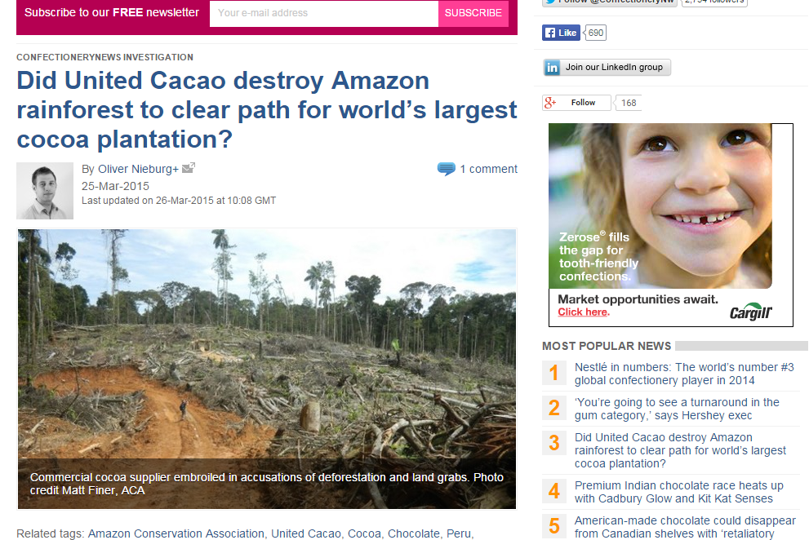
Notes:
What did we create? What is global forest watch?
Online global forest monitoring and management platform
Harnesses power
satellite imagery
cloud computing
crowdsourcing
open data
Provide free, accessible, easy-to-understand information about what’s happening in forests around the world in near-real time
GATHER forest information from
satellite imagery
open data from governments, companies, NGOs, etc,
on the ground
ANALYZE using cloud computing, GIS, etc.
SHARE with everyone, but most importantly with key decision makers

Slide 7



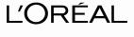
















Corporate Commitments
November 2011
March-April 2014
December 2013
Jan-Feb 2014
May-Sept. 2014
Climate and Land Use Alliance, Cascade of Corporate Commitments to Zero-Deforestation Palm Oil (Sept., 2014)
Notes:
Beginning with Nestle’s commitment in 2011…
Many commodity producers, traders, and consumer goods manufacturers have come on-board with commitments to zero-deforestation commodity sourcing – this chart just looks at commitments to palm oil.
Producers and traders represented = >60% of trade in palm oil.
The New York declaration brought even more to the table and now we’re seeing many of these commitments extended beyond the palm oil sector.

Slide 8
The Question
Can we predict the locations where large-scale forest clearing is most likely to occur next?

Slide 9

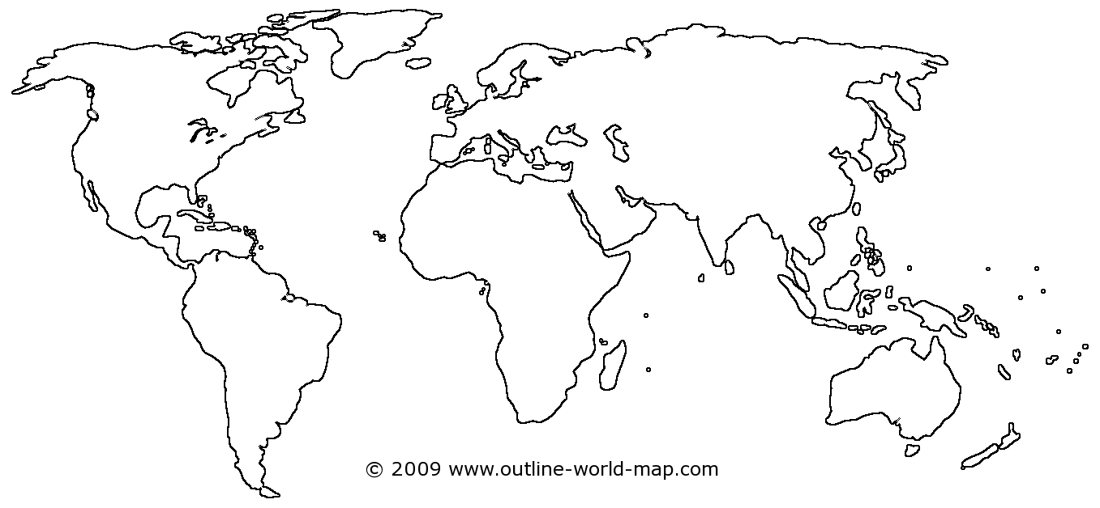

The Data: FORMA
500 m – 16 day – MODIS NDVI – FIRMS – Precipitation → continuous probability
World Resources Institute and Center for Global Development, https://github.com/wri/forma-clj
Notes:
Using satellite-derived data -- output of an algorithm
Normalized Difference Vegetation Index
Rainfall from the Precipitation Reconstruction over Land data set
3. Daily active fire detections identifies by FIRMs

Slide 10
The Data: FORMA
500 12 11 2080 869 -23.62291666666668 -56.02609512946262 PRY 63 121434 60150 0 [0 0 0 0 0 0 0 0 0 0 0 0 0 0 0 0 0 0 0 0 0 0 0 0 0 0 0 0 0 0 0 0 0 0 0 0 0 0 0 0 1 1 1 2 2 3 5 8 14 21 29 35 38 39 40 40 40 40 40 41 42 43 44 45 46 46 47 47 48 48 48 48 48 48 48 48 48 48 48 48 48 48 48 48 48 49 50 51 52 52 52 52 52 53 53 53 53 53 53 53 53 53 53 53 53 53 53 53 53 53 54 56 57 58 59 59 60 60 60 60 60 60 60 60 60 60 60 60 60 60 60 62 63 64 65 66 67 68 68 69 70 70 70 70 70 70 70 70 70 70 70 70 72 75 77 79 80 81 82 82 82 83 83 83 84 85 85 86 86 86 87 88 88 89 90 91 92 93 94 95 95 96 96 96 96 96 96 96 97 97 97 97 97 97 97 97 97 98 98 98 98 98 98 98 98 99 99 99 99 99 99 99 99]
World Resources Institute and Center for Global Development, https://github.com/wri/forma-clj

Slide 11
The Data: FORMA
Satellite row and path
500 12 11 2080 869 -23.62291666666668 -56.02609512946262 PRY 63 121434 60150 0 [0 0 0 0 0 0 0 0 0 0 0 0 0 0 0 0 0 0 0 0 0 0 0 0 0 0 0 0 0 0 0 0 0 0 0 0 0 0 0 0 1 1 1 2 2 3 5 8 14 21 29 35 38 39 40 40 40 40 40 41 42 43 44 45 46 46 47 47 48 48 48 48 48 48 48 48 48 48 48 48 48 48 48 48 48 49 50 51 52 52 52 52 52 53 53 53 53 53 53 53 53 53 53 53 53 53 53 53 53 53 54 56 57 58 59 59 60 60 60 60 60 60 60 60 60 60 60 60 60 60 60 62 63 64 65 66 67 68 68 69 70 70 70 70 70 70 70 70 70 70 70 70 72 75 77 79 80 81 82 82 82 83 83 83 84 85 85 86 86 86 87 88 88 89 90 91 92 93 94 95 95 96 96 96 96 96 96 96 97 97 97 97 97 97 97 97 97 98 98 98 98 98 98 98 98 99 99 99 99 99 99 99 99]
World Resources Institute and Center for Global Development, https://github.com/wri/forma-clj

Slide 12
The Data: FORMA
500 12 11 2080 869 -23.62291666666668 -56.02609512946262 PRY 63 121434 60150 0 [0 0 0 0 0 0 0 0 0 0 0 0 0 0 0 0 0 0 0 0 0 0 0 0 0 0 0 0 0 0 0 0 0 0 0 0 0 0 0 0 1 1 1 2 2 3 5 8 14 21 29 35 38 39 40 40 40 40 40 41 42 43 44 45 46 46 47 47 48 48 48 48 48 48 48 48 48 48 48 48 48 48 48 48 48 49 50 51 52 52 52 52 52 53 53 53 53 53 53 53 53 53 53 53 53 53 53 53 53 53 54 56 57 58 59 59 60 60 60 60 60 60 60 60 60 60 60 60 60 60 60 62 63 64 65 66 67 68 68 69 70 70 70 70 70 70 70 70 70 70 70 70 72 75 77 79 80 81 82 82 82 83 83 83 84 85 85 86 86 86 87 88 88 89 90 91 92 93 94 95 95 96 96 96 96 96 96 96 97 97 97 97 97 97 97 97 97 98 98 98 98 98 98 98 98 99 99 99 99 99 99 99 99]
latitude
longitude
World Resources Institute and Center for Global Development, https://github.com/wri/forma-clj

Slide 13
The Data: FORMA
ISO
500 12 11 2080 869 -23.62291666666668 -56.02609512946262 PRY 63 121434 60150 0 [0 0 0 0 0 0 0 0 0 0 0 0 0 0 0 0 0 0 0 0 0 0 0 0 0 0 0 0 0 0 0 0 0 0 0 0 0 0 0 0 1 1 1 2 2 3 5 8 14 21 29 35 38 39 40 40 40 40 40 41 42 43 44 45 46 46 47 47 48 48 48 48 48 48 48 48 48 48 48 48 48 48 48 48 48 49 50 51 52 52 52 52 52 53 53 53 53 53 53 53 53 53 53 53 53 53 53 53 53 53 54 56 57 58 59 59 60 60 60 60 60 60 60 60 60 60 60 60 60 60 60 62 63 64 65 66 67 68 68 69 70 70 70 70 70 70 70 70 70 70 70 70 72 75 77 79 80 81 82 82 82 83 83 83 84 85 85 86 86 86 87 88 88 89 90 91 92 93 94 95 95 96 96 96 96 96 96 96 97 97 97 97 97 97 97 97 97 98 98 98 98 98 98 98 98 99 99 99 99 99 99 99 99]
World Resources Institute and Center for Global Development, https://github.com/wri/forma-clj

Slide 14
The Data: FORMA
500 12 11 2080 869 -23.62291666666668 -56.02609512946262 PRY 63 121434 60150 0 [0 0 0 0 0 0 0 0 0 0 0 0 0 0 0 0 0 0 0 0 0 0 0 0 0 0 0 0 0 0 0 0 0 0 0 0 0 0 0 0 1 1 1 2 2 3 5 8 14 21 29 35 38 39 40 40 40 40 40 41 42 43 44 45 46 46 47 47 48 48 48 48 48 48 48 48 48 48 48 48 48 48 48 48 48 49 50 51 52 52 52 52 52 53 53 53 53 53 53 53 53 53 53 53 53 53 53 53 53 53 54 56 57 58 59 59 60 60 60 60 60 60 60 60 60 60 60 60 60 60 60 62 63 64 65 66 67 68 68 69 70 70 70 70 70 70 70 70 70 70 70 70 72 75 77 79 80 81 82 82 82 83 83 83 84 85 85 86 86 86 87 88 88 89 90 91 92 93 94 95 95 96 96 96 96 96 96 96 97 97 97 97 97 97 97 97 97 98 98 98 98 98 98 98 98 99 99 99 99 99 99 99 99]
ecoregion
World Resources Institute and Center for Global Development, https://github.com/wri/forma-clj

Slide 15
The Data: FORMA
500 12 11 2080 869 -23.62291666666668 -56.02609512946262 PRY 63 121434 60150 0 [0 0 0 0 0 0 0 0 0 0 0 0 0 0 0 0 0 0 0 0 0 0 0 0 0 0 0 0 0 0 0 0 0 0 0 0 0 0 0 0 1 1 1 2 2 3 5 8 14 21 29 35 38 39 40 40 40 40 40 41 42 43 44 45 46 46 47 47 48 48 48 48 48 48 48 48 48 48 48 48 48 48 48 48 48 49 50 51 52 52 52 52 52 53 53 53 53 53 53 53 53 53 53 53 53 53 53 53 53 53 54 56 57 58 59 59 60 60 60 60 60 60 60 60 60 60 60 60 60 60 60 62 63 64 65 66 67 68 68 69 70 70 70 70 70 70 70 70 70 70 70 70 72 75 77 79 80 81 82 82 82 83 83 83 84 85 85 86 86 86 87 88 88 89 90 91 92 93 94 95 95 96 96 96 96 96 96 96 97 97 97 97 97 97 97 97 97 98 98 98 98 98 98 98 98 99 99 99 99 99 99 99 99]
World Resources Institute and Center for Global Development, https://github.com/wri/forma-clj

Slide 16
The Data: FORMA
Probability as of December 2005
…as of April 2015
500 12 11 2080 869 -23.62291666666668 -56.02609512946262 PRY 63 121434 60150 0 [0 0 0 0 0 0 0 0 0 0 0 0 0 0 0 0 0 0 0 0 0 0 0 0 0 0 0 0 0 0 0 0 0 0 0 0 0 0 0 0 1 1 1 2 2 3 5 8 14 21 29 35 38 39 40 40 40 40 40 41 42 43 44 45 46 46 47 47 48 48 48 48 48 48 48 48 48 48 48 48 48 48 48 48 48 49 50 51 52 52 52 52 52 53 53 53 53 53 53 53 53 53 53 53 53 53 53 53 53 53 54 56 57 58 59 59 60 60 60 60 60 60 60 60 60 60 60 60 60 60 60 62 63 64 65 66 67 68 68 69 70 70 70 70 70 70 70 70 70 70 70 70 72 75 77 79 80 81 82 82 82 83 83 83 84 85 85 86 86 86 87 88 88 89 90 91 92 93 94 95 95 96 96 96 96 96 96 96 97 97 97 97 97 97 97 97 97 98 98 98 98 98 98 98 98 99 99 99 99 99 99 99 99]
World Resources Institute and Center for Global Development, https://github.com/wri/forma-clj

Slide 17
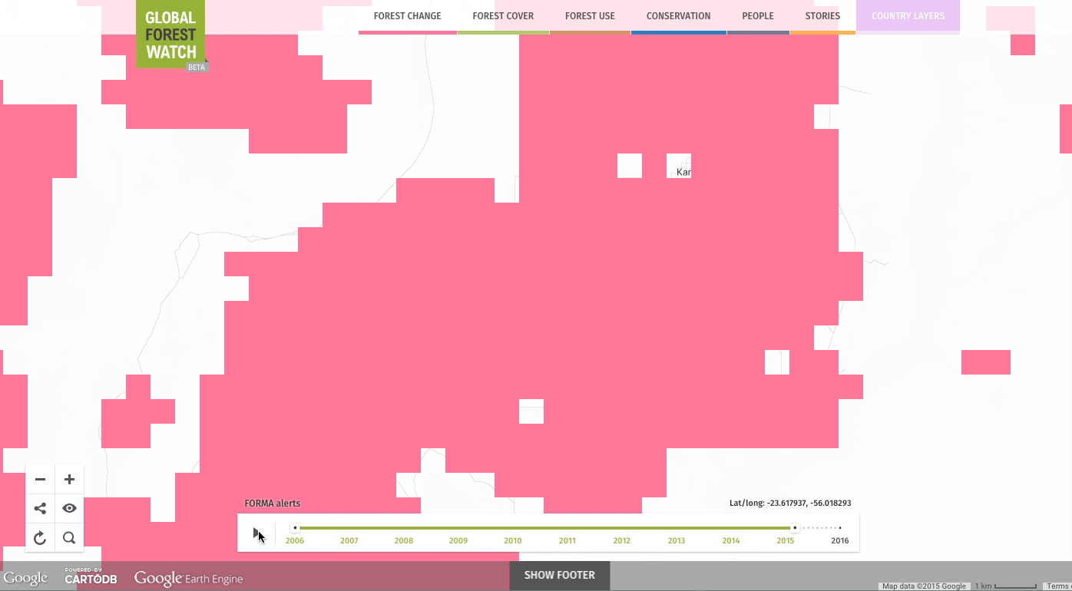

Slide 18
The Prediction
Probability as of December 2005
…as of April 2015
500 12 11 2080 869 -23.62291666666668 -56.02609512946262 PRY 63 121434 60150 0 [0 0 0 0 0 0 0 0 0 0 0 0 0 0 0 0 0 0 0 0 0 0 0 0 0 0 0 0 0 0 0 0 0 0 0 0 0 0 0 0 1 1 1 2 2 3 5 8 14 21 29 35 38 39 40 40 40 40 40 41 42 43 44 45 46 46 47 47 48 48 48 48 48 48 48 48 48 48 48 48 48 48 48 48 48 49 50 51 52 52 52 52 52 53 53 53 53 53 53 53 53 53 53 53 53 53 53 53 53 53 54 56 57 58 59 59 60 60 60 60 60 60 60 60 60 60 60 60 60 60 60 62 63 64 65 66 67 68 68 69 70 70 70 70 70 70 70 70 70 70 70 70 72 75 77 79 80 81 82 82 82 83 83 83 84 85 85 86 86 86 87 88 88 89 90 91 92 93 94 95 95 96 96 96 96 96 96 96 97 97 97 97 97 97 97 97 97 98 98 98 98 98 98 98 98 99 99 99 99 99 99 99 99]
? ? ? ?
World Resources Institute and Center for Global Development, https://github.com/wri/forma-clj

Slide 19
Fitting the Model
train
out of sample
val1 | val2 | val3 | val4 | val5 | val6 | … | val(n) | val(n+1) | val(n+2)
4 | 4 | 10 | 11 | 15 | 20 | … | 45 | ? | ?
test
Notes:
Go back into time, predict into present

Slide 20
Workflow
Scoping: Loop through 2000+ ASCII files to read in/splice files containing “IND” ISO code
Feature engineering: extract new features such as historical and neighborhood trends
Calculate distance to roads
Training and Testing
Challenge: Dynamic model that is refitted with new observations
Notes:
Change over time, last three changes, summary of surrounding changes – how do I best represent my sample data?
Feature engineering – process of transforming raw data into features that better represent underlying problem to the predictive models – resulting in improve model accuracy on unseen data

Slide 21
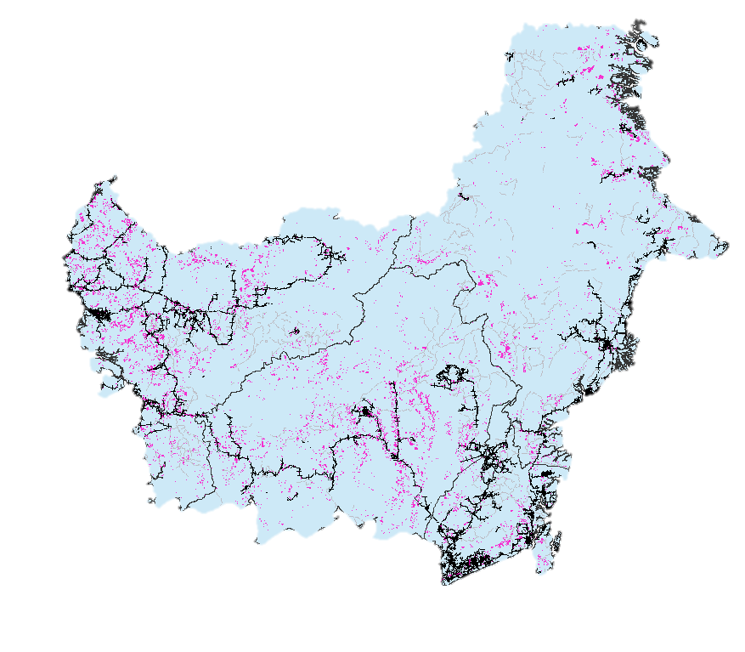
Proximity Analysis

Slide 22
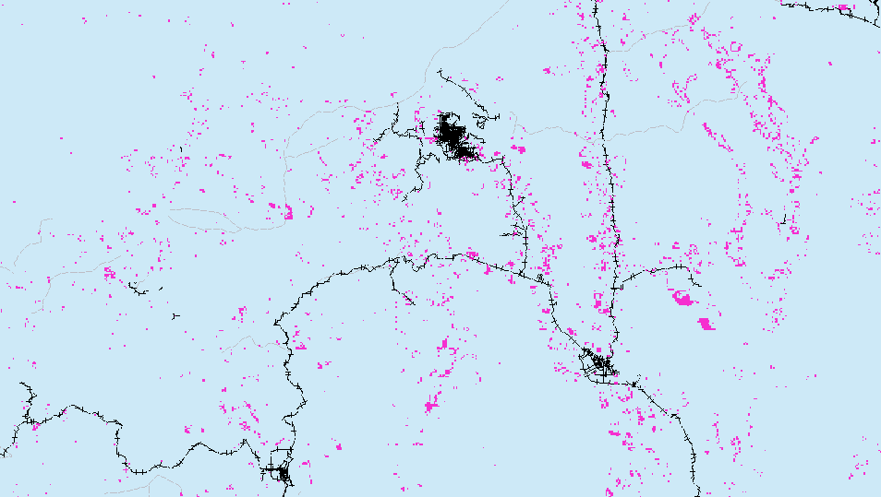
Proximity Analysis

Slide 23
Questions? Learn more at www.globalforestwatch.org

